Slide 1
COMPOUNDS
Mrs. Huddleston
6th Grade Language Arts

Slide 2
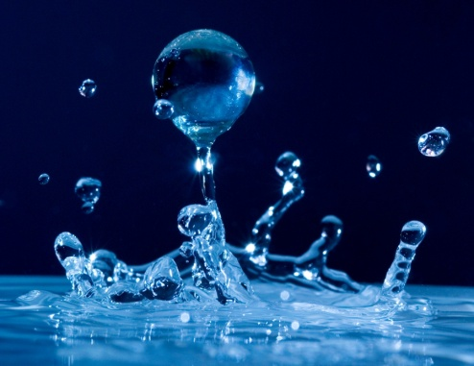
“Compound” means…
Two or more things joined together
H
If two hydrogen molecules and one oxygen molecule joined together, they would create a compound for water: H2O.
H
O

Slide 3
Compound Words
Compound Words are two words that join together to create a new word.
?
base
ball

Slide 4
Can you create a compound word from this list?
Pass
Sun
Fire
Rattle
Butter
Touch
Snake
Works
Flies
Down
Flower
Port

Slide 5
Compound Sentences
You can also combine sentences.
Jo is a scientist.
She travels often.
Jo is a scientist, and she travels often.

Slide 6
In order to combine sentences…
You need to add a COMMA and a CONJUCTION between the two sentences.
for
and
nor
but
or
yet
so
Sentence 1
,
sentence 2.

Slide 7
Compound Sentence Examples
Will you go to Peru?
Will you do more research?
Will you go to Peru will you do more research?
Prehistoric people had no alphabet.
They drew signs.
Prehistoric people had no alphabet they drew signs.
,
or
but
,

Slide 8
Is the sentence correct?
Ancient people drew these pictures but they probably never saw any of them whole.
No!
Where’s the comma?

Slide 9
Is the sentence correct?
The drawings in Peru are old, but they remain clear.
Yes!
It has a comma and conjunction.

Slide 10
Is the sentence correct?
The pictures are seen best from the air, and now people take photographs of them from airplanes.
Yes!
It has a comma
and a conjunction.

Slide 11
Is the sentence correct?
Most of the pictures are in Peru, other countries have some too.
No!
Where’s the conjunction?

Slide 12
Is the sentence correct?
Scientists have studied these pictures and many books have been written about them.
No!
Where’s the comma?

Slide 13
Help me complete these compound sentences…
Bob liked to eat…
A. Bob liked to eat chocolate and drink iguana juice.
B. Bob liked to eat pickled relish on his ice-cream.
C. Bob liked to eat, and then go to sleep.
D. Bob liked to eat, but he hated being full.

Slide 14
Help me complete these compound sentences…
Sally and her sister…
1. Sally and her sister went to the park.
2. Sally and her sister swam by the pool and dried in the sun.
3. Sally and her sister wanted new clothes, so they went to the mall.
4. Sally and her sister hated spiders, but loved cats.

Slide 15
Help me complete these compound sentences…
They sang all night…
A. They sang all night and slept all day.
B. They sang all night, yet they weren’t tired.
C. They sang all night until morning.
D. They sang all night and then their voices hurt.

Slide 16
Compound sentences: ticket out
Put an X in front of each sentence that is a compound sentence. For those sentences, write the coordinating conjunction that joins the two shorter sentences.
_____ _________1. Crayons were invented in 1903 by Edwin Binney and Harold Smith, and they were an instant success.
_____ _________2. Cross word puzzles can be diamond-shaped, or they can be square.
_____ _________3. The first Ferris wheel began operating on June 21, 1893 at the Chicago’s World’s Fair.
_____ _________4. It had 36 wooden cars that could each seat 40 people, but most modern Ferris wheels are much smaller.
_____ _________5. A kaleidoscope is a tube one can look into that makes beautiful, colorful patterns using mirrors.

Slide 17
Your assignment…on a separate sheet of paper.
Write 10 compound sentences.
Highlight the comma and conjunction (FANBOYS) in each sentence.
Circle the verbs.
Write a new verb above each old verb.
Have a prepositional phrase in each sentence and put (parentheses) around it.
Example: By nine o’clock , China atomized Australia, and
the world cried.
decimated
(:
)
grieved

Slide 18
Let’s practice…
1. Start a sentence with a subject and a verb…
Bathman fought Duckie
2. Then add on another subject and verb sentence…
Duckie beat Bathman
3. Make sure you put a comma and conjunction in between…
Bathman fought Duckie, but then Duckie beat Bathman
4. Add a preposition.
Bathman fought Duckie (in the perilous bathtub), but then Duckie beat Bathman.
5. Change your verbs.
Fought = challenged; beat = pummeled

Slide 19
Final sentence
Bathman fought Duckie in the
perilous bathtub , but then
Duckie beat Bathman.
challenged
(
)
pummeled

Slide 20
Vocabulary
devastating
nurturing
ponder
anonymous
tolerant
proprietor
valise
anesthetic
conscious
extinguished

